Slide 1
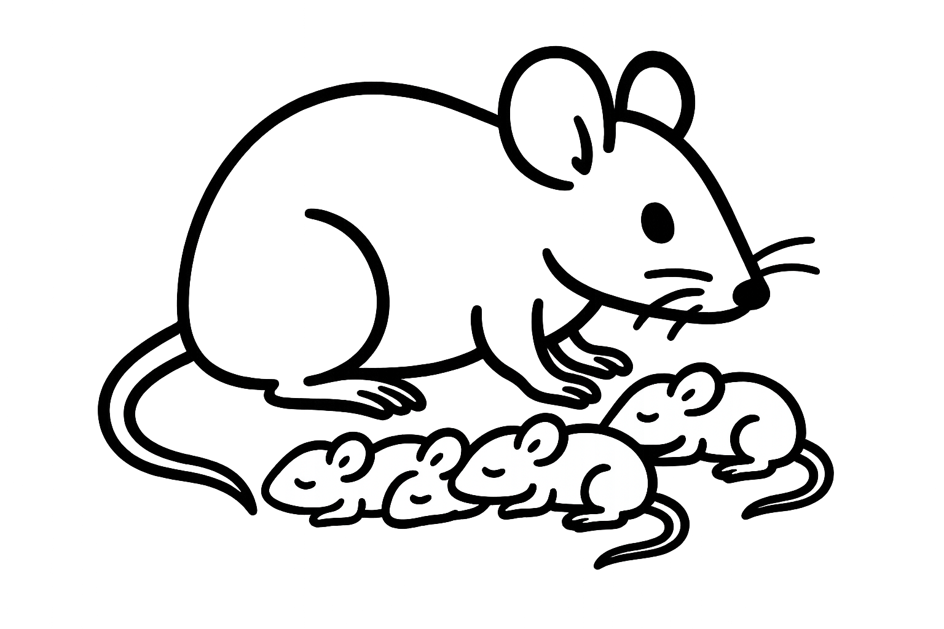
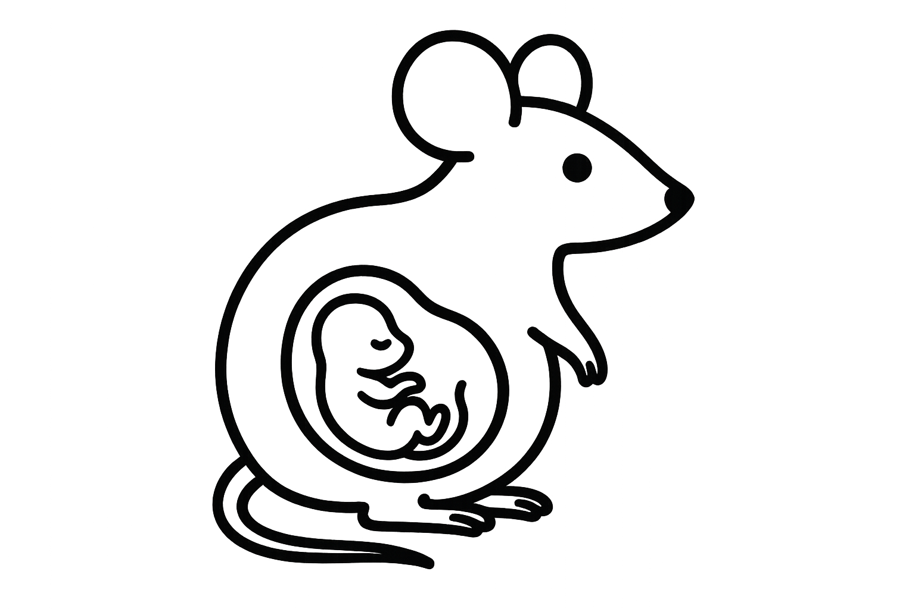
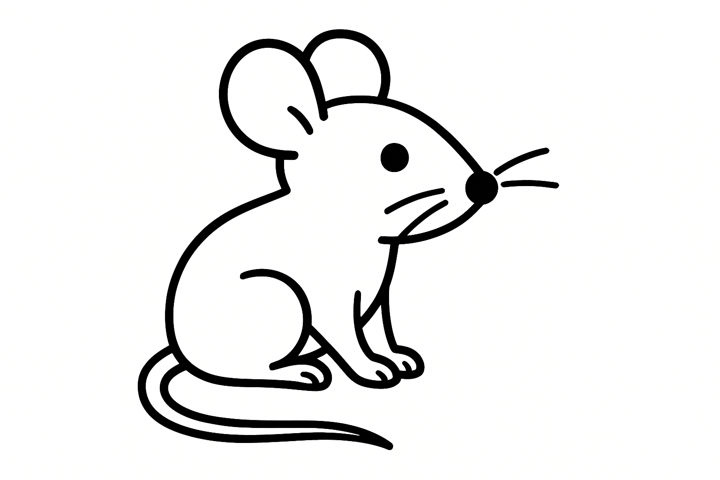

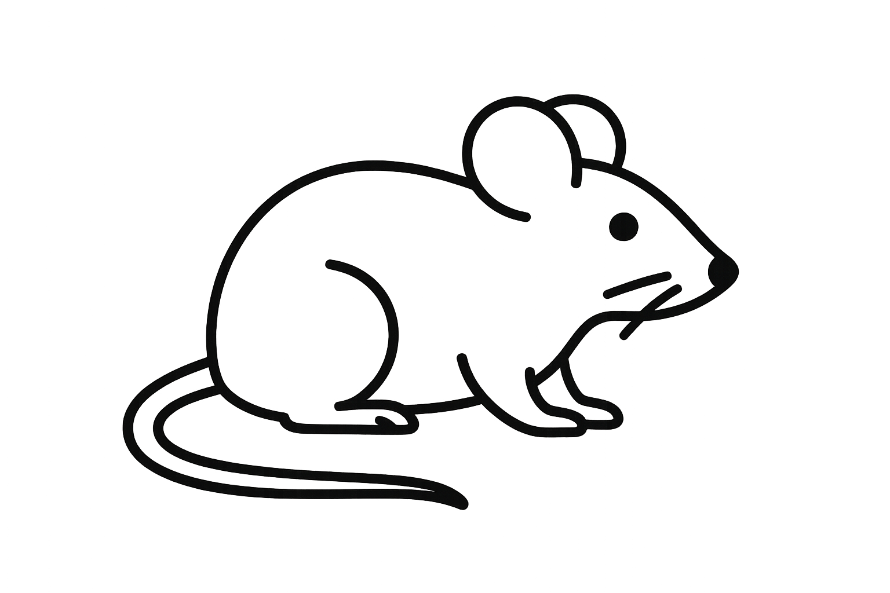
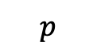

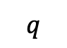
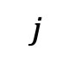
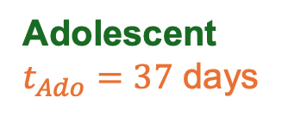
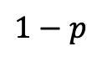
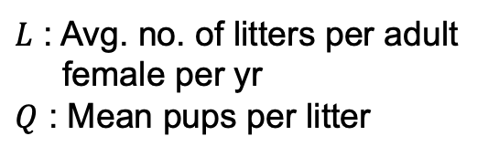
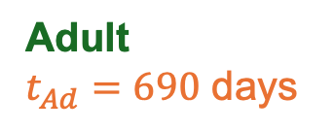
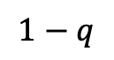
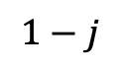
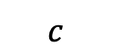
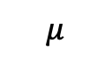
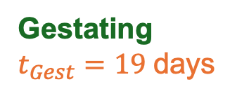
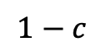
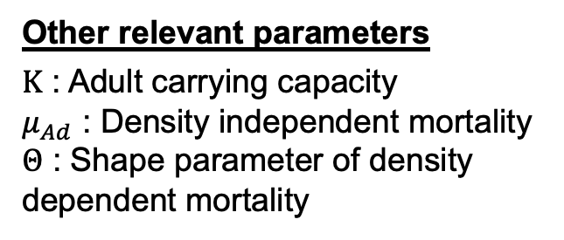
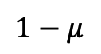
a
b
Nursing
$t_{Nurs}=23 \text{days}$
$$1−j$$
HDR
yMM
$$1−c$$
$$c$$
yMW
1 cut
$$j$$
$$1−p$$
yME
NHEJ
$$p$$
yMV
yMW
M can be either E or V
Adolescent
$t_{Ado}=37 \text{days}$
Gestating
$t_{Gest}=19 \text{days}$
c
$$1−q$$
yWE
$$1−μ$$
$$μ$$
yWW
1 cut
$$q$$
yWV
Adult
$t_{Ad}=690 \text{days}$
Cut 1
Cut 1 and cut 2 are independent
yWW
Other relevant parameters
$K$ : Adult carrying capacity
$μ_{Ad}$ : Density independent mortality
$Θ$ : Shape parameter of density dependent mortality
Cut 2
$L$ : Avg. no. of litters per adult
female per yr
$Q$ : Mean pups per litter
Female specific dominant/recessive mutation
Y-Linked Editor

